Slide 1
AGURCHAND MANMULL JAIN SCHOOL
MEENAMBAKKAM, CHENNAI – 600 114

Slide 2
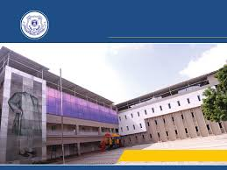
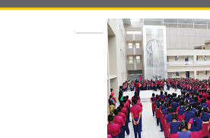
A.M.JAIN SCHOOL

Slide 3
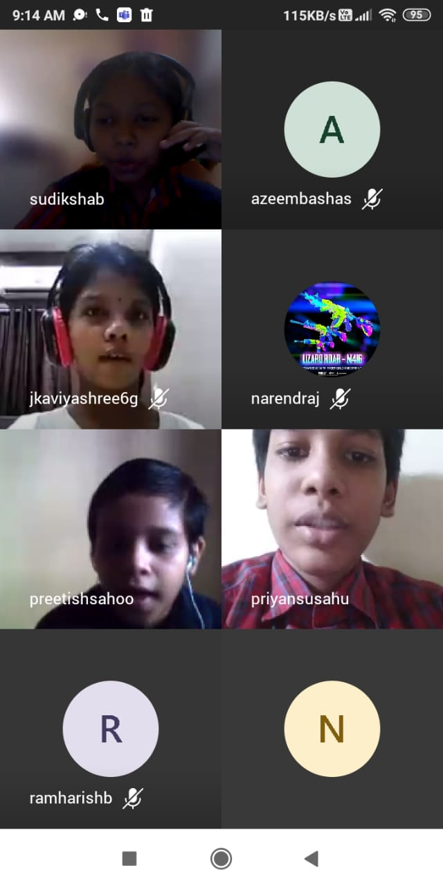
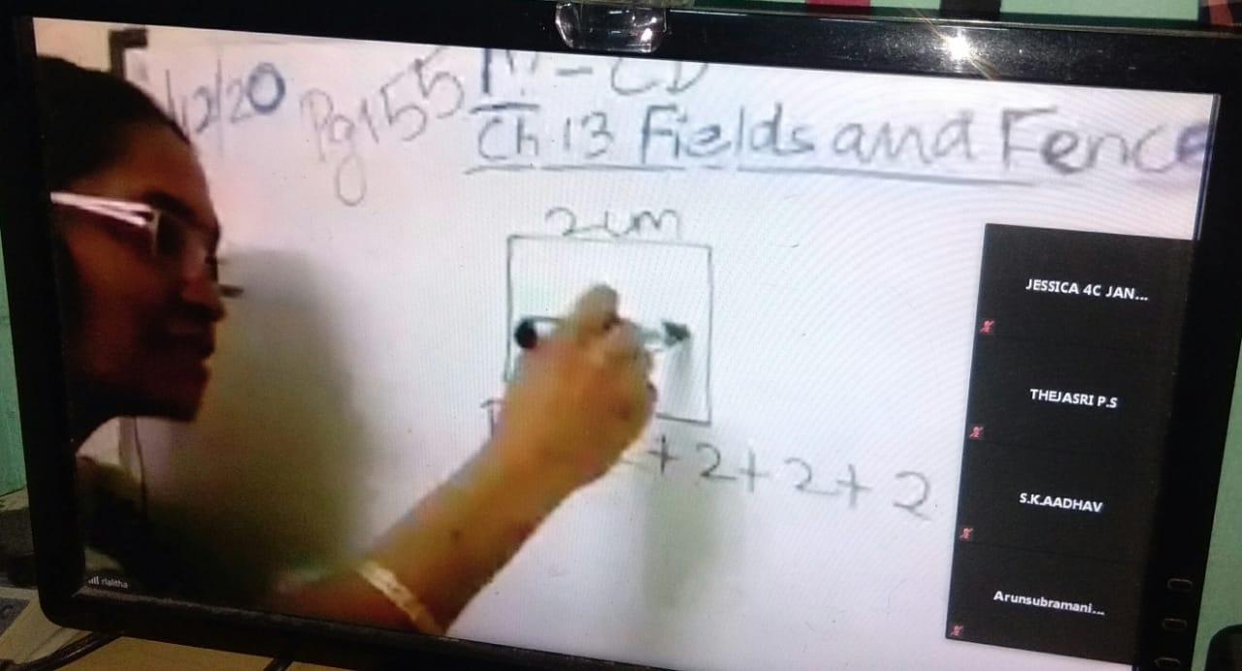
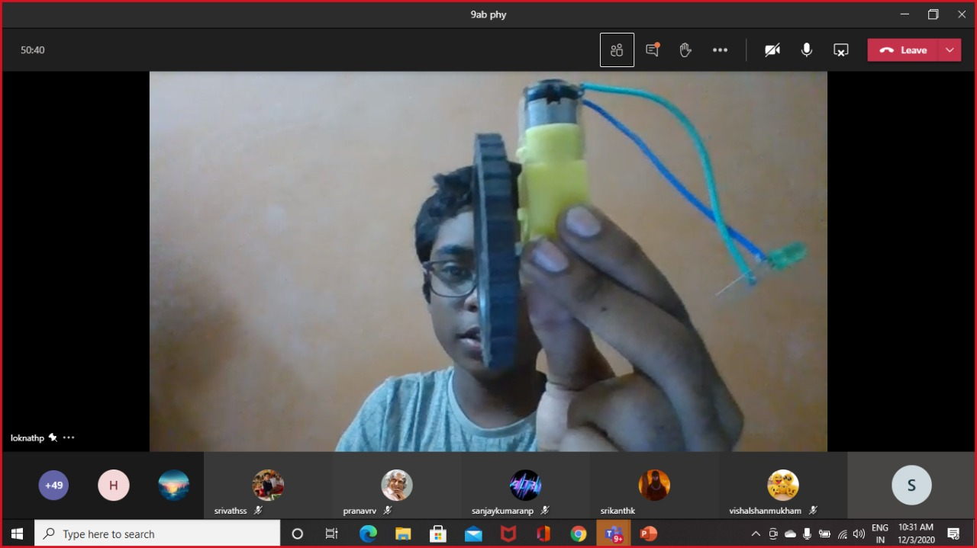
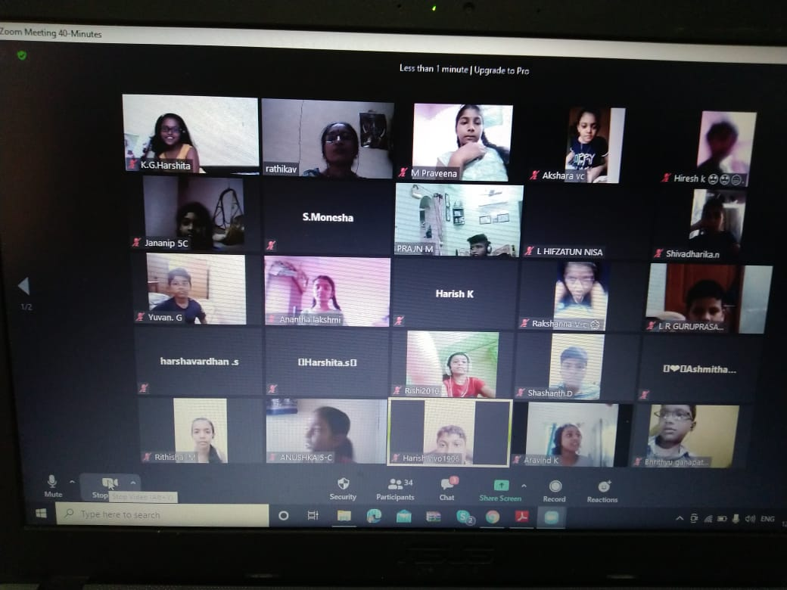
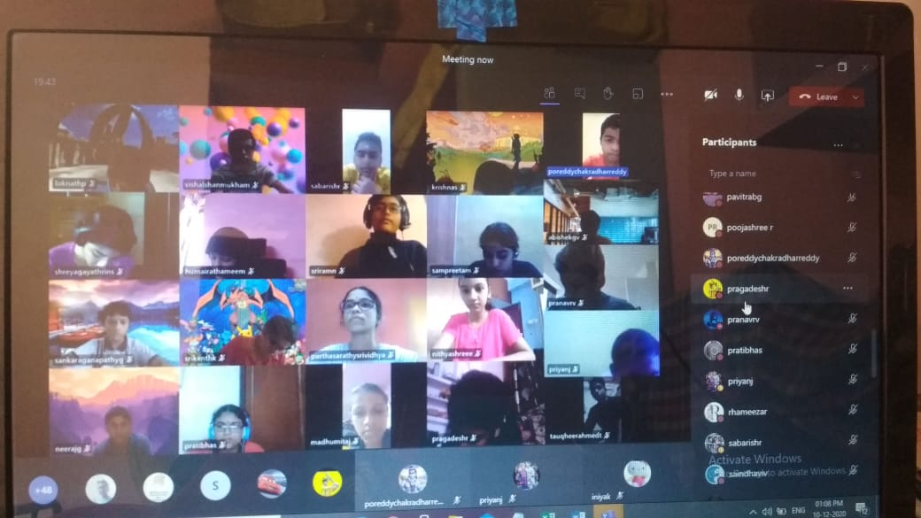
ONLINE CLASSES

Slide 4
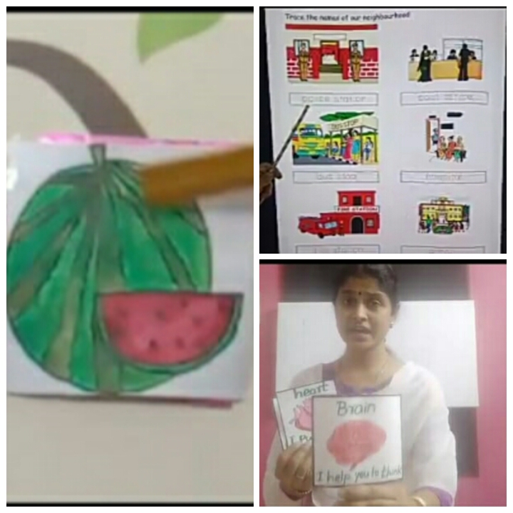
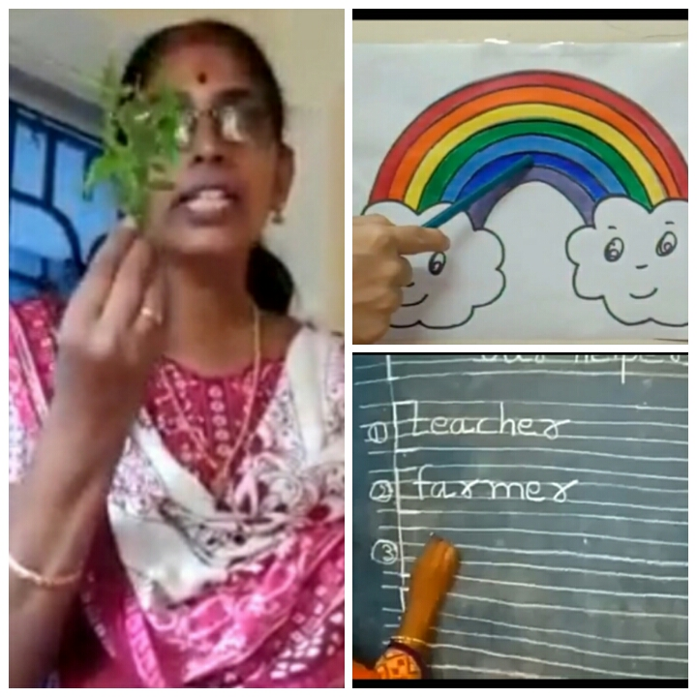
Zoom online classes and activities to continue school at home during coronavirus.It is a good platform to address some academic issues/challenges/problems/ doubts etc. that support the stake holders to get deeper understanding on subjects and concepts. In connection with the same thought, it was also a need from A.M. Jain School teachers to experience such platform as they were finding out few solutions to overcome this particular lockdown situation with some technical implications while dealing all the subjects teaching through zoom from classes 1 to 12. So this was a prior effort of our school, was initially done which put a sturdy base for the students on learning, planning and visualizing classes to their home. The teachers were given email id and logged in as a mentor and student and cleared their doubts by teaching and practiced the tools by their own.

Slide 6
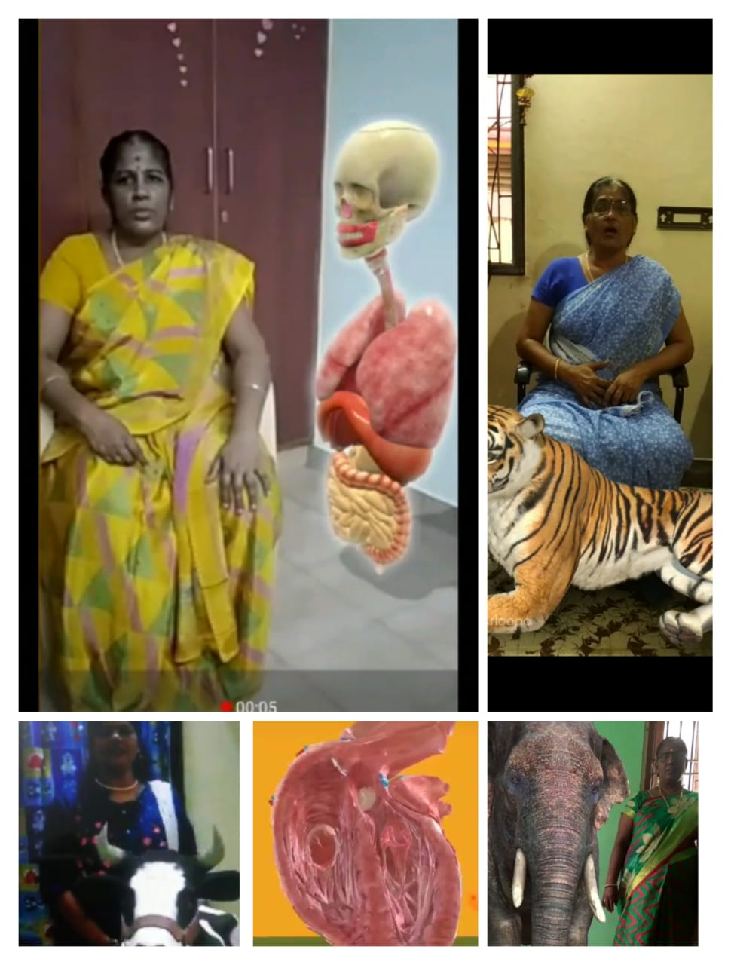
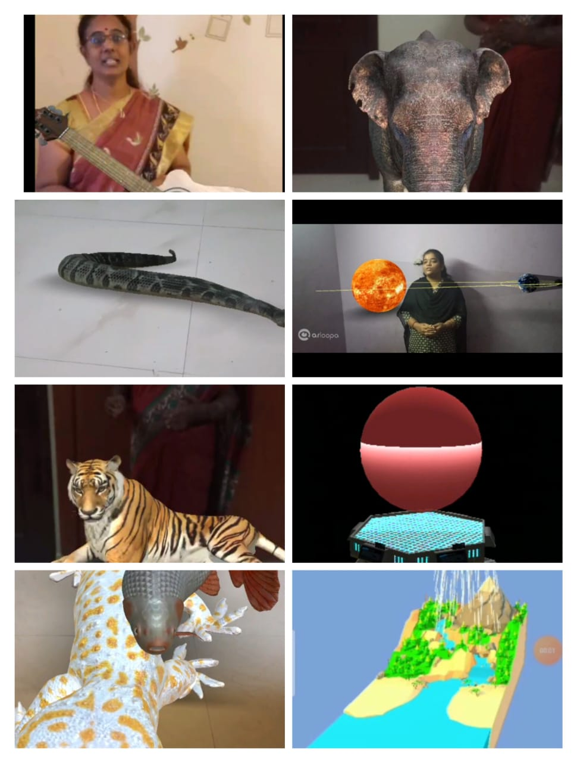
AUGMENTED REALITY PRESENTATION

Slide 7
Art must be integrated with the teaching and learning process of all academic subjects from classes 1 to 12, to promote active/experiential learning for “connecting knowledge to life outside the school, ensuring that learning shifts away from rote methods and for enriching the curriculum, so that it goes beyond textbooks”.

Slide 8
Cent percent result in Class X in the year 2019-20
Agurchand Manmull Jain School has a big reason to rejoice during these pandemic times, with the CBSE Class X results making waves of happy news in the entire AMJS family across the globe. Our children had appeared for their Class X exams and achieved a 100% pass percentage. This year again, AMJS students have lived up to the expectations of the parents and the teachers with a proud smile of accomplishment on every face. Their overall percentiles and hundred percent marks in many subjects have set a new benchmark for all AMJS students to aim for the stars.
Cent percent result in Class X in the year 2019-20
Agurchand Manmull Jain School has a big reason to rejoice during these pandemic times, with the CBSE Class X results making waves of happy news in the entire AMJS family across the globe. Our children had appeared for their Class X exams and achieved a 100% pass percentage. This year again, AMJS students have lived up to the expectations of the parents and the teachers with a proud smile of accomplishment on every face. Their overall percentiles and hundred percent marks in many subjects have set a new benchmark for all AMJS students to aim for the stars.

Slide 9
The PTM meeting was conducive and fruitful. It was a nice forum to reflect upon the child's progress and areas of development. The meeting helped to create better understanding between parents and teachers and build harmonious relationship between the school and the community. The event witnessed around 85% attendance thus displaying enthusiastic interest among parents for the smooth working and progress of the school.

Slide 10
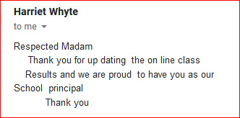

Slide 11
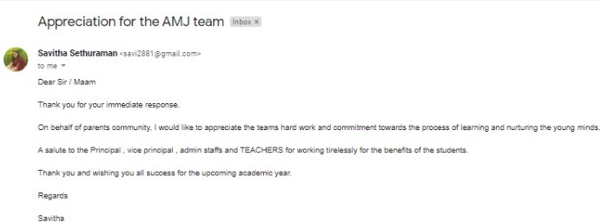

Slide 12
A report card is a short-term report of the student's grade. A student will get a report card for the duration of a grading period. No matter what age the student or what grade they are in, online report cards from School Cues are flexible, easy-to-use and highly configurable; a gift to schools. This is important for all students, particularly for high school and transfer students where their complete academic performance is charted. Teachers can also leave comments and track attendance. Whether it is report cards or transcripts which need to be emailed or printed, the data is consolidated and customized. This easy-to-use online Student report cards allows a school to streamline the process of grading and generating transcripts.
TERM-1 REPORT CARDS

Slide 13
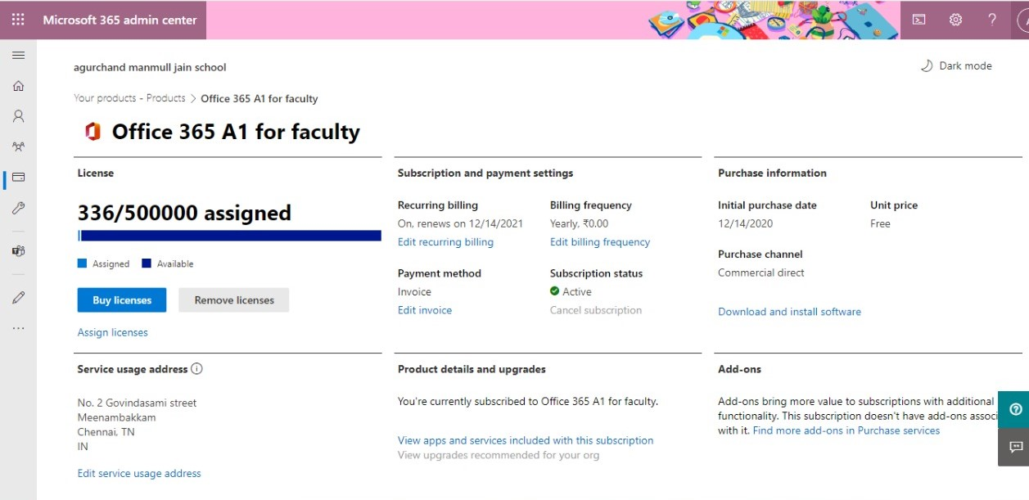
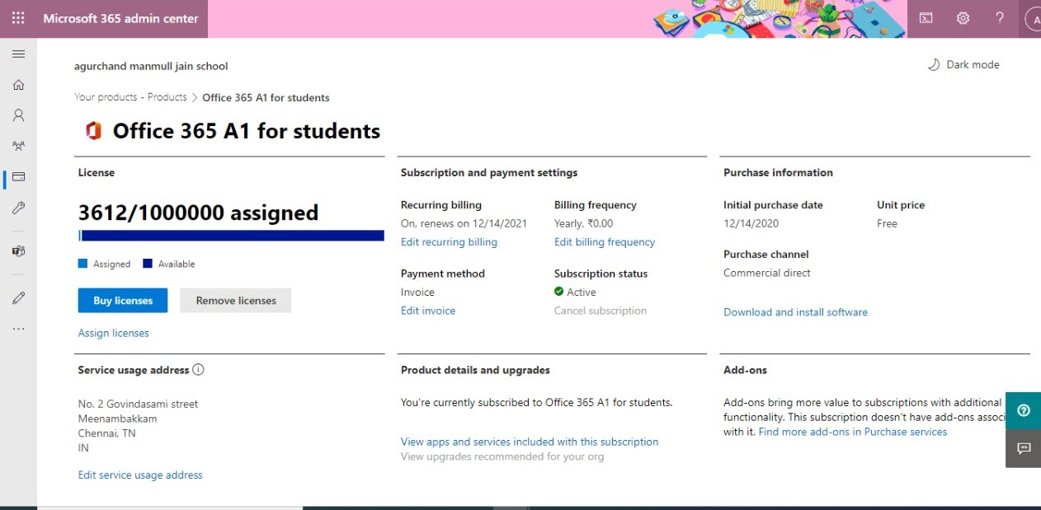
Our Journey continues with Microsoft

Slide 14
TEACHERS’ DAY CELEBRATION
Teachers’ Day is celebrated in our country on mark of Dr. Sarvepalli Radhakrishnan’s birthday.
Dr. Sarvepalli Radhakrishnan (5 September 1888 – 17 April 1975) was an Indian philosopher, academic, and statesman who served as the first Vice President of India (1952–1962) and the second President of India (1962–1967).
Dr. Radhakrishnan believed that "teachers should be the best minds in the country". Since 1962, his birthday has been celebrated in India as Teachers' Day on 5 September every year.
In our school, we celebrated virtual teachers’ day on 5th September 2020. Teachers of our school gave speech about Dr.Radhakrishnan, students of our school portrayed teachers’ specialties. The students performed various programmes like dance about Guru, Guru Sloka, and Guru Song. Documentary film about Dr.Radhakrishnan was telecasted. On the theme of Happy family- Jain family video played about our school teachers.
The most highlighted programme was students’ surprise video about teachers with lots of love.

Slide 15
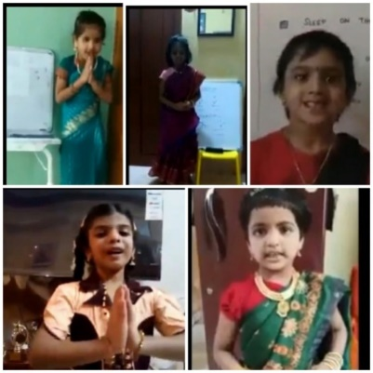
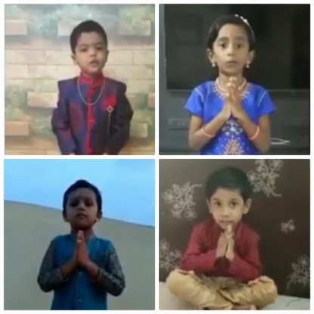
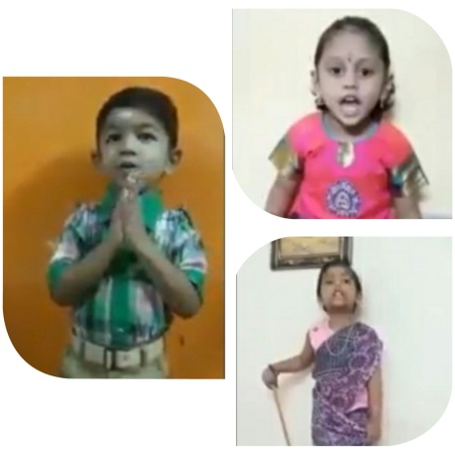
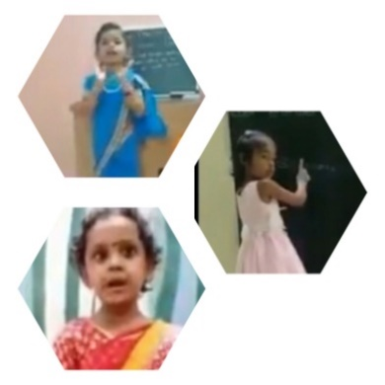
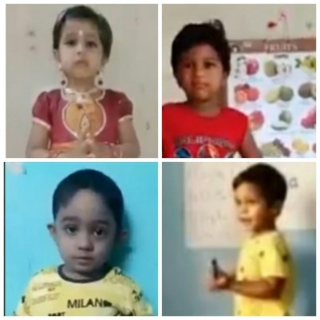
Children took part in the celebration of teacher’s day with speech, enactment as teachers and guru slokas.

Slide 16
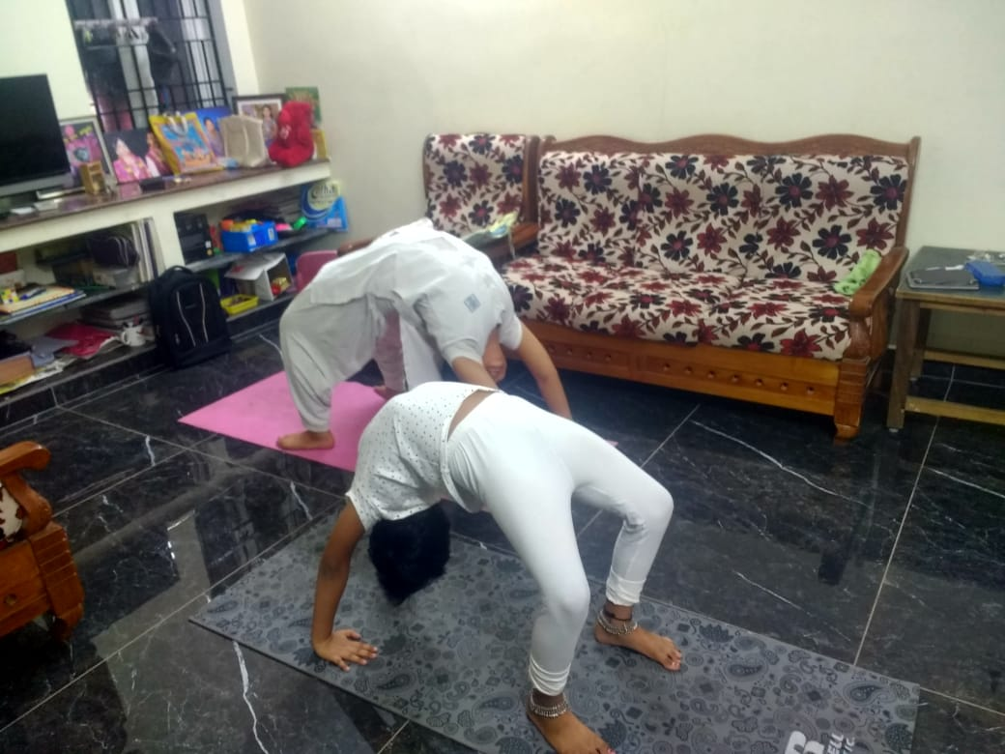
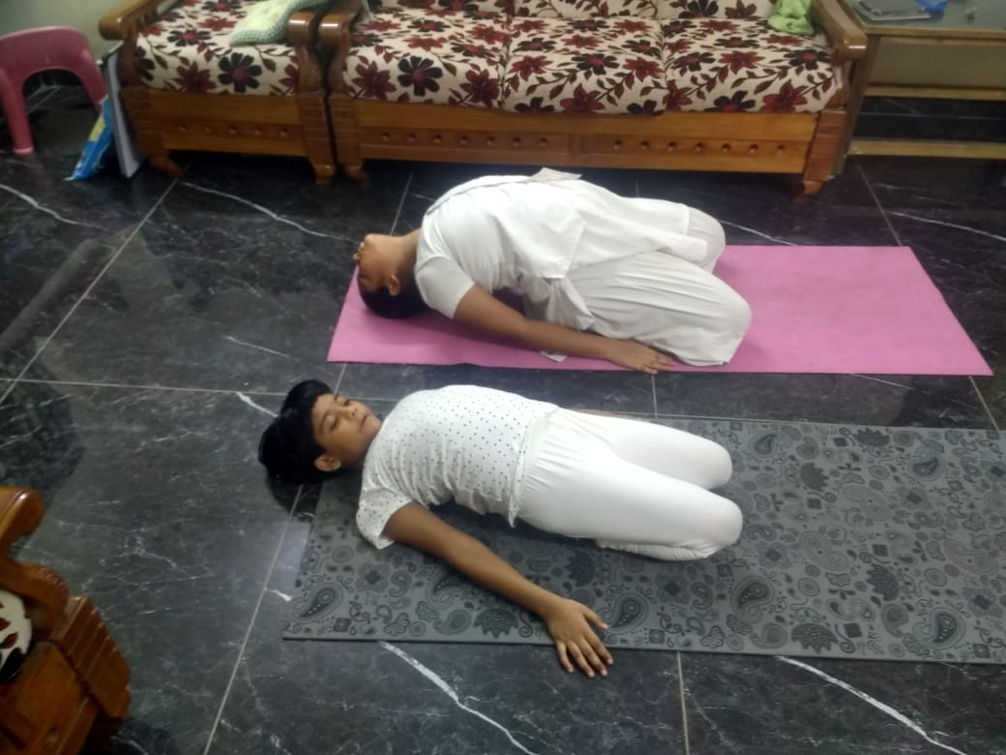
The A.M.Jain School celebrated yoga for the year of 2020 June 21st .

Slide 17
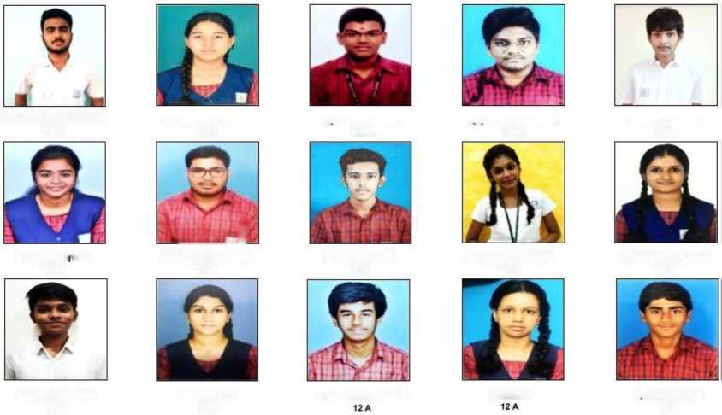
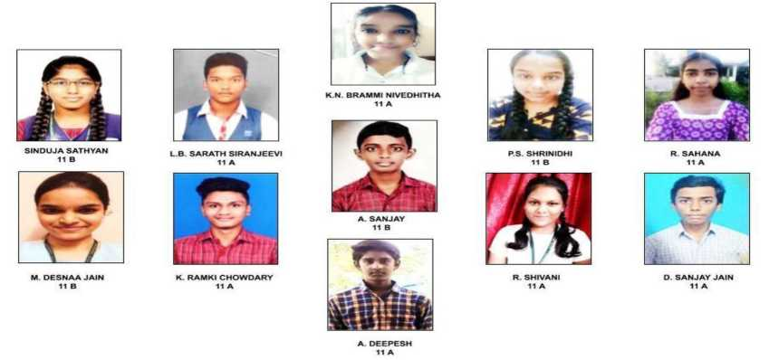
VIRTUAL ELECTION 2020 - 21 (ELECTED CANDIDATES-LEADERS)
VIRTUAL ELECTION 2020-21 (ELECTED CANDIDATES ASSISTANT LEADERS)

Slide 18
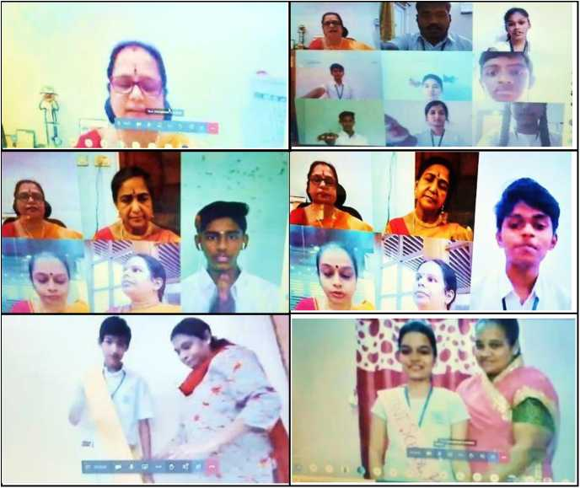
To inculcate leadership qualities among students the school pupil leader election will be conducted every academic year in our school to select leaders and assistant leaders.
To honour the leaders and assistant leaders, we have celebrated Virtual investiture ceremony on August 14th 2020. Investiture ceremony is one of the most important events of any school. The celebration on that day makes every child who is elected as leader feel proud as well as a sense of responsibility to be leaders in making for tomorrow. The members of the students’ council were introduced.
The Principal Pramodaa Menon led them to the oath taking ceremony and enabled the leaders, realize their responsibilities and to be human

Slide 19
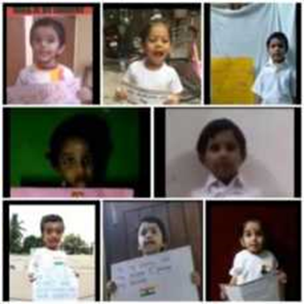

Slide 20
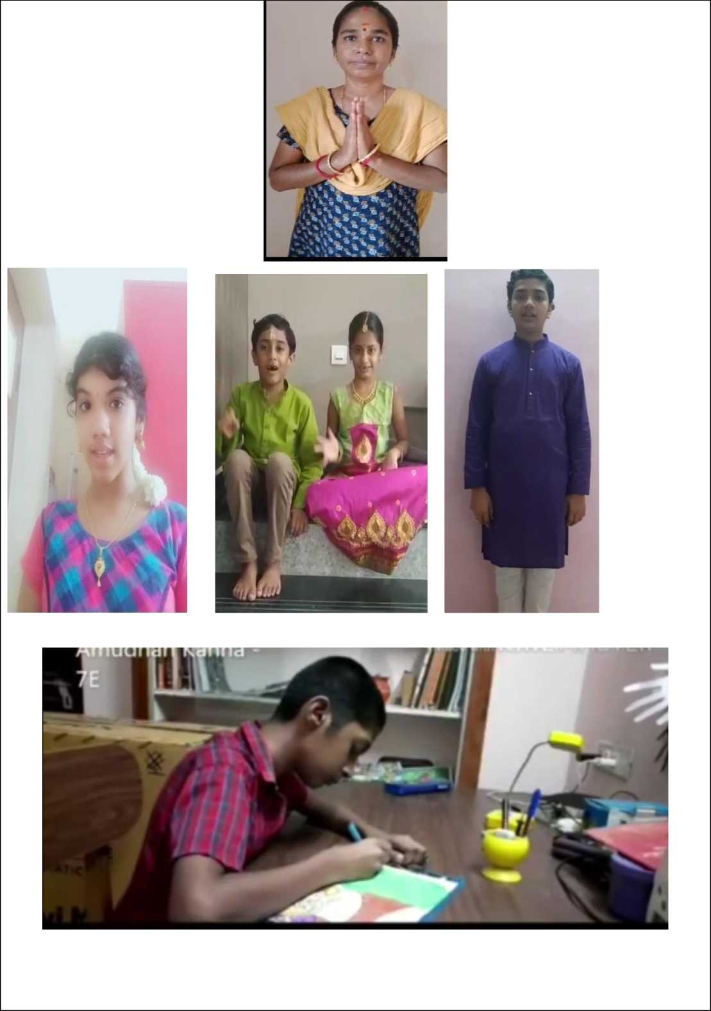
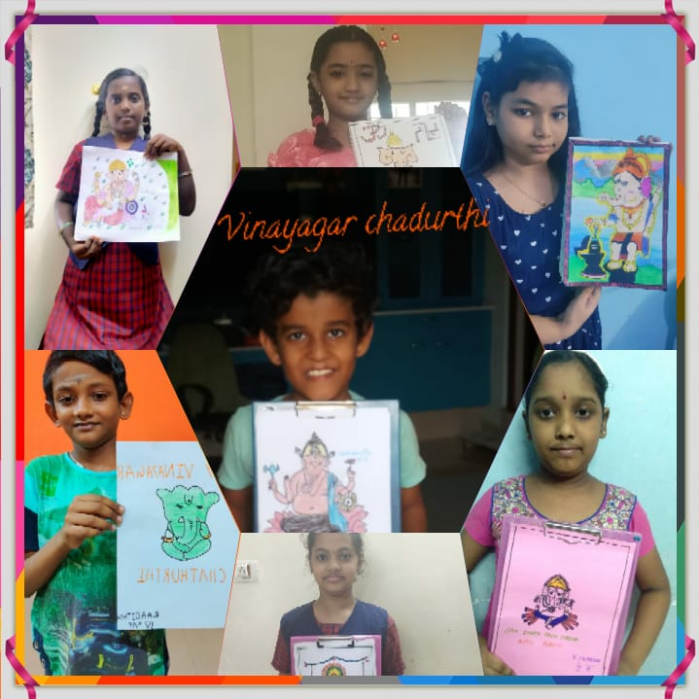
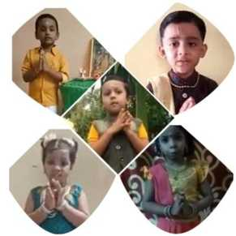
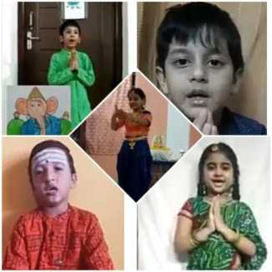
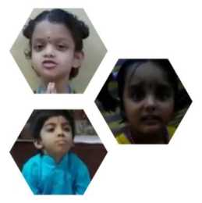
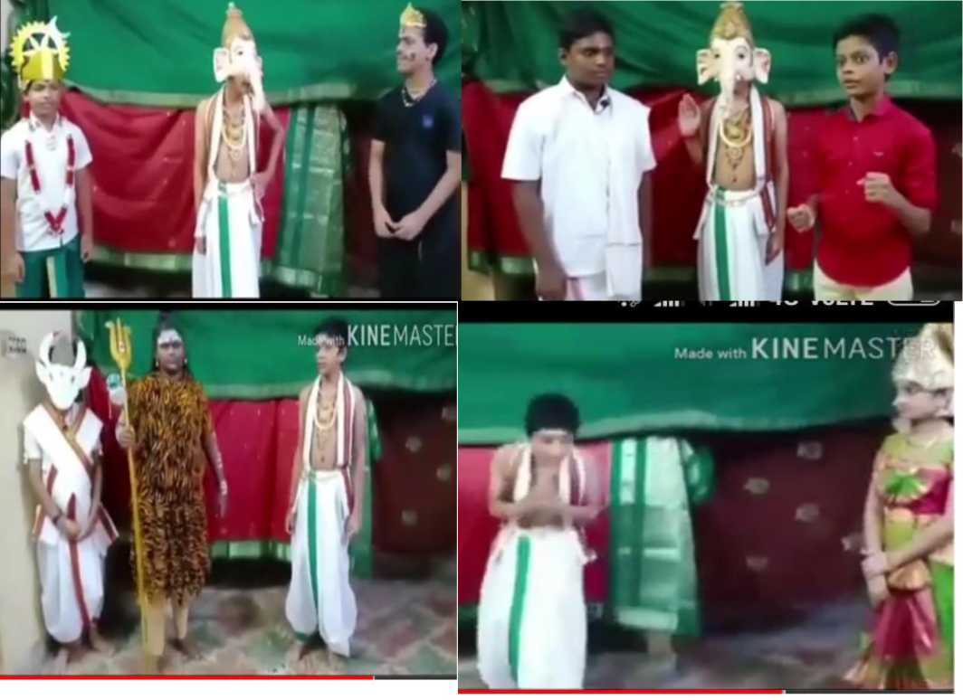
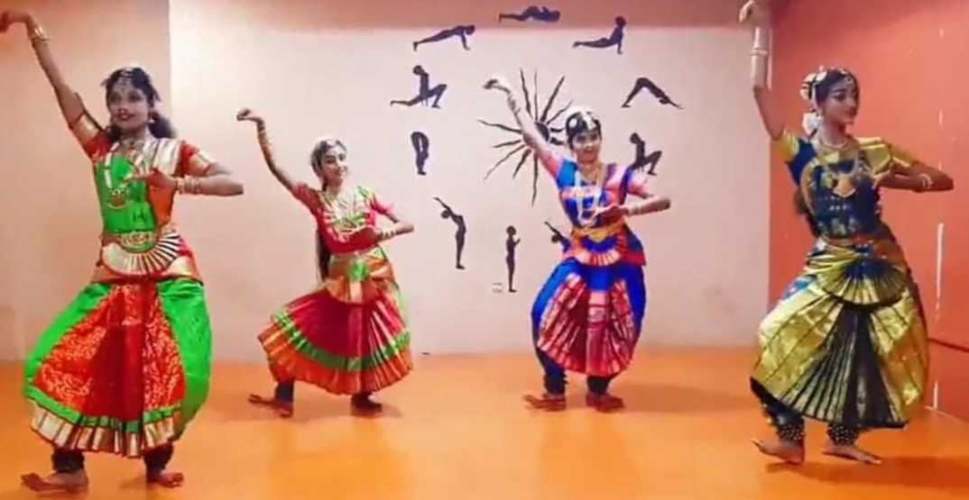
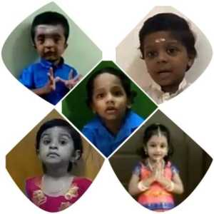
VINAYAGAR CHATURTHI CELEBRATION

Slide 22
FOUNDER’S DAY CELEBRATION
Our school’s Founder’s 118 ^{th} birthday was celebrated on 25 ^{th} August 2020 virtually, in a grand manner. The programme started with a Prayer. Dr.Venkataramanan, Principal of A.M. Jain College and other dignitaries offered garland to our Founder’s statue Padmashri Mohanmullji Chordia to show our reverence.
Later, he addressed the gathering. Dr.G.K. Francis Director of A.M.Jain College and Dr.Rajendran the former Principal of A.M. Jain College, came up with felicitation speech. Ms.Rajalakshmi, Assistant professor of A.M Jain College, recited the poem in Hindi.
Ms.Angyarkanni, Tamil teacher of A.M.Jain School, recited the poem in Tamil on our Founder.
As a tribute video was played on our Founder Shri. Padmashri Mohanmullji Chordia as a tribute. A.M. Jain College students performed dance, A.M.jain school students performed dance and sang a song. Students of A.M.Jain school also portrayed the painting of our Founder.
The Principal, Ms.Pramodaa Menon of A.M.Jain school, presented a bouquet to our Secretary Sir Shri.Sardarmal Chordia as a token of love. The Secretary Shri Sardarmal Chordia fulfilled the event with thanks giving message. Ms.Pramodaa Menon delivered the vote of thanks.

Slide 23
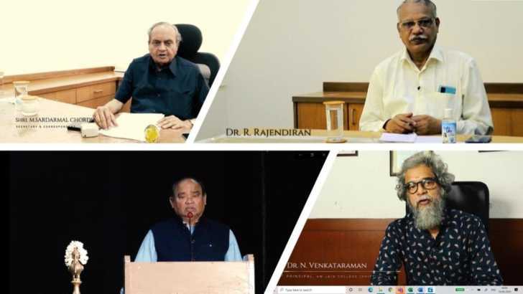
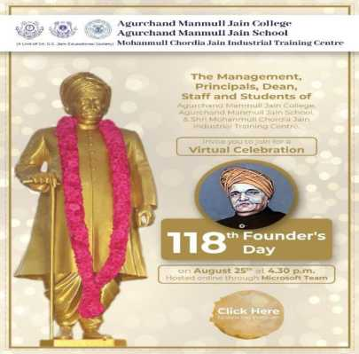

Slide 24
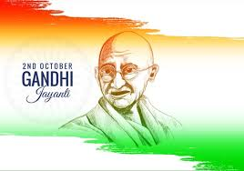
Gandhi Jayanthi day virtual celebration is celebrated on October 2nd 2020 in our school starting with Flag Hoisting by our Principal Ms.Pramodha Menan followed by lighting Kuthu vilakku. The Programme started with Prayer and Tamizhthai vazhthu.
Our Principal mam addressed to our students showed by Gandhi documentary.
Teachers given their speech about Gandhi ji in different languages like English, Tamil and Hindi. Students performed debate, bhajan, dance, jugalbandi about Gandhiji. Like a Crown, students performed Villupattu very well. Also slogans and monoact performed.
With vote of thanks and National Anthem programme was over.

Slide 25
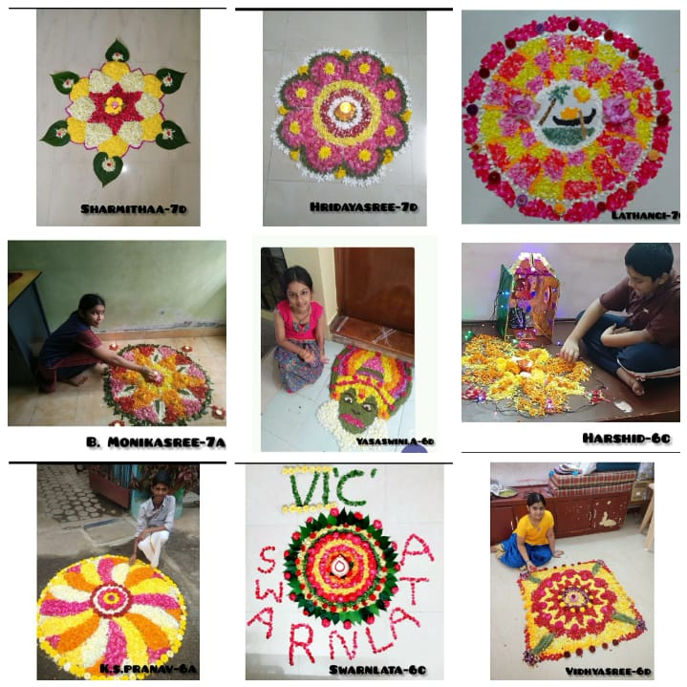
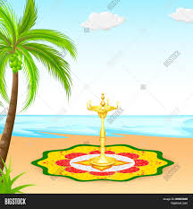
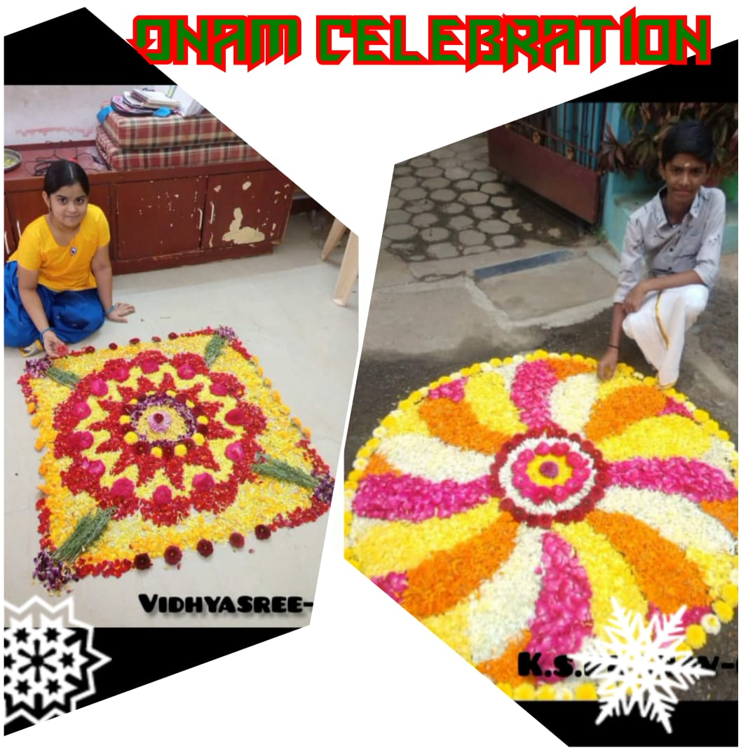

Slide 26
Dr. Abdul Kalam’s Birthday Celebration

Slide 27
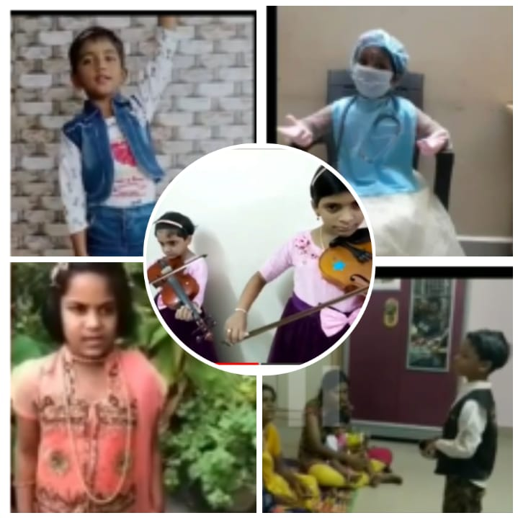

Slide 28
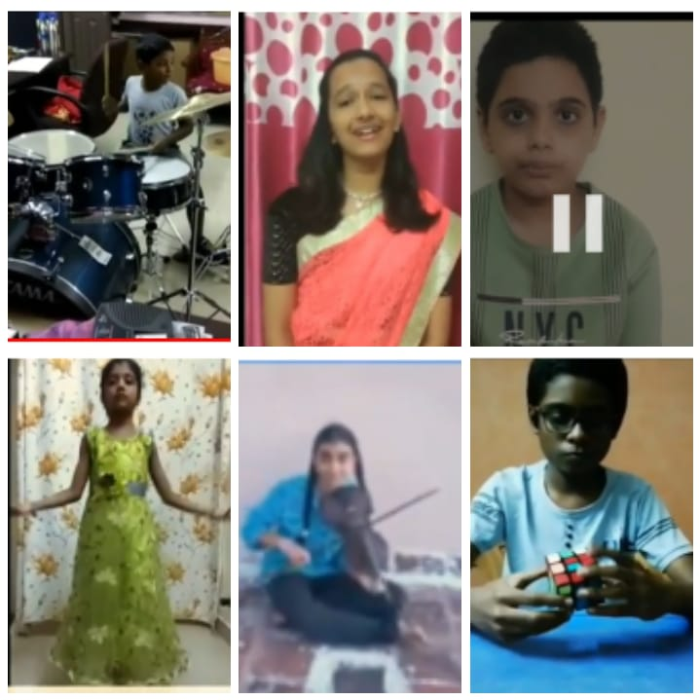

Slide 29
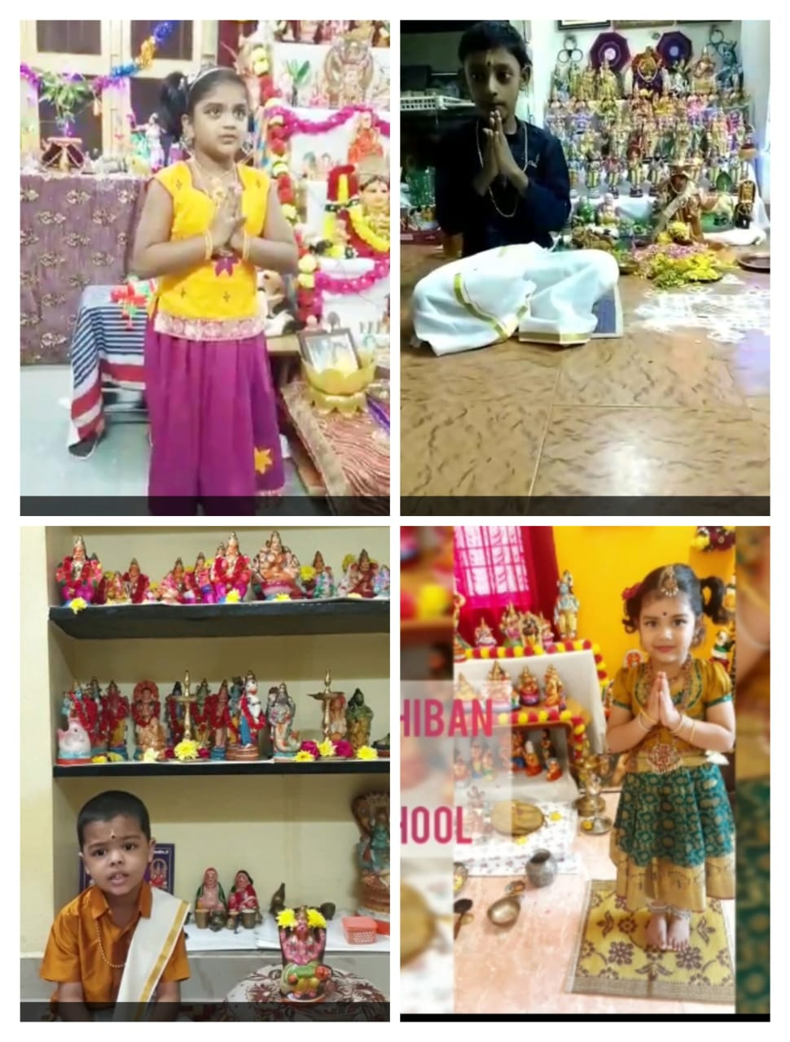
A.M.JAIN SCHOOL

Slide 30
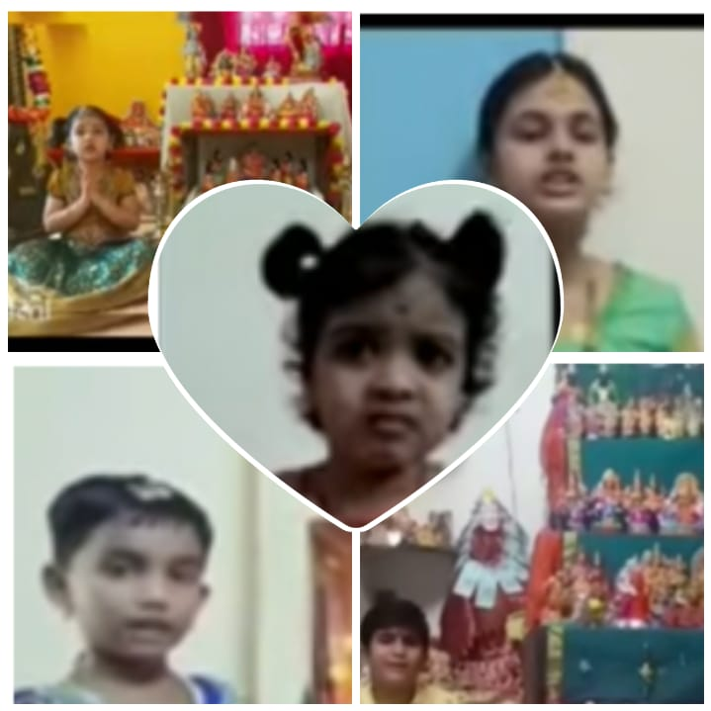
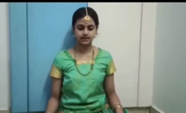

Slide 31
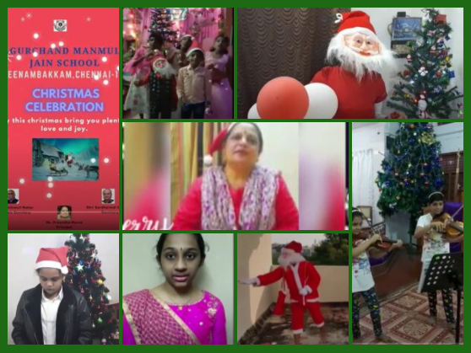

Slide 32
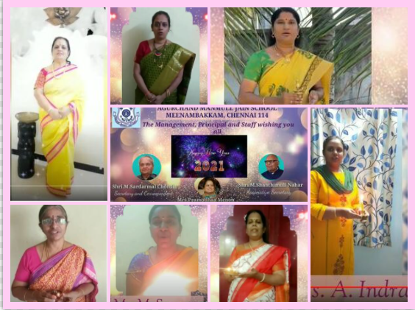
Offline New Year Celebration

Slide 33
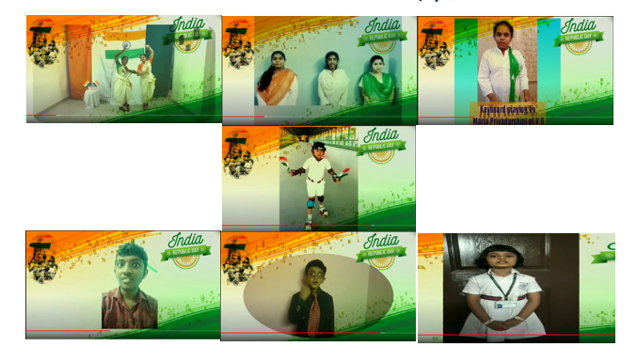
Republic Day Celebration
Republic day celebration at school
Republic Day was celebrated in all its solemnity and grandeur at A.M.Jain School on 26th January 2021.Our Principal ma'am, vice principals,Teachers and students were saluted the National Flag and pledged themselves to upholding the honour and integrity, diversity and uniqueness that is “ India”.

Slide 34
Martyrs day 2021
January 30 is marked as Martyrs Days, to honour and pay homage to those martyrs who gave the ultimate sacrifice for the freedom, welfare and progress of our beloved country. It was on January 30, 1948 when Mahatma Gandhi was assassinated. And, since then every year the nation pays homage to the Mahatma and other martyrs on this day. On this day A.M.Jain school teachers and students took sparsh leprosy
awareness pledge in Tamil and Hindi. Tamil Speech was given by Ms.Nithyasree of class 12 to understand the importance of sparsh leprosy awareness.

Slide 35
COMPETITIONS

Slide 36
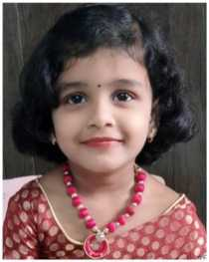
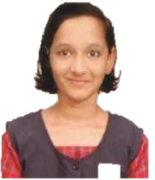
PARAMPARA COMPETITION
the parampara competition was held on 8th august 2020, conducted online and offline competition
SAMRUDHI PUNNIYAKOTTI UKG - 3RD PRIZE IN ROLE PLAY
DHANANTHRAM.H
2C EVENT —FANCY DRESS
I PRIZE(ONLINE)
SHRUTHI.S -11A
EVENT —SHIP WRECK (ONLINE )
III-PRIZE FLAGGED EVENT
SAI PURA.V -7C SEMI CLASSICAL (ONLINE)
III-PRI ZE
NEELAM JAIN -8A
VEGETABLE AND FRUIT CARVING
II-PRIZE (OFFLINE)

Slide 37
GANDAGI MUKT MERA GOA
online painting competition for 6 to 8th students . all the students participated enthusiastically and showed their talents.

Slide 38
CBSE ONLINE ESSAY COMPETITION

Slide 39
WORLD DE-ADDICTION DAY
International day against drug abuse and illicit trafficking was observed. Wherein various activities conducted to create awareness and instil a sense of responsibility among the students. Our A.M Jain School students made many posters and making slogan writing.

Slide 40
DEADDICTION OATH ON 26TH JUNE 2020

Slide 41
VIRTUAL EUKARYOTIC CELL USING CELL WORLD
A virtual tour of an eukaryotic cell was shown to the students of classes VIII and IX. The app 'cell world 'was used. Students enthusiastically watched the different organelles present in the cell.

Slide 42
TALENT SHOW
HAPPY TOTS CONDUCTED TALENT SHOW FOR TEACHER’S ON 5TH SEPTEMBER 2020 :
SINDHUJA OF KG WON THE 2ND PRIZE FOR SOLO SINGING
GROUP DANCE BY KG TEACHERS ( RESHMAJAIN.P, LATHASUKUMAR , SANTHANALAKSHMI.C , SRIVIDHYA.G , VIDHYA.S , KANCHANA.R , SHIYAMALADEVI.P ) WON THE 3RD PRIZE.
Other kg teacher’s participated in group song, solo singing and solo dance in talent show competition conducted by the happy tots .

Slide 43
In the wake of extension of lockdown in the country, the Central Board of Secondary Education (CBSE) has asked schools to shift the method of teaching. The CBSE asked schools to adopt an activity-based curriculum instead of current text-based learning methods. We have prepared annual plans with activity-based “meaningful and joyful learning experiences” For Kindle Kids & sporty fun & Art Contest our kids participated in the events enthusiastically and uploaded the video performances with their family support on creative aspects.

Slide 44
Hindustan International School – Karapakkam conducted ESPERANZA 2020 on 29th November through virtual mode due to the ongoing pandemic. The theme of ESPERANZA is bring out the talents of the students with loads of fun, all from the comfort of their home.
Our school students enthusiastically participated in these culturals through virtual. Totally 6 students were participated. It is proud to say that Srikriti of class 9D won the II prize in Golden Instruments.

Slide 45
Desh Apnayen Citizen Clubs will be threaded together in a common social media framework. This provides a vibrant platform to establish a community of like-minded teachers as well as students. Sharing of best practices and showcasing of achievements are encouraged and suitably rewarded.

Slide 46
This year to celebrate Mahatma Gandhi’s birth anniversary, Students Solar Ambassador Workshop adopted the theme of the Global Clean Environment Movement, under which a webinar was organized titled “Role of Youth in Attaining Atmanirbhar Bharat in Energy”, focussing on World Energy Scenario, Climate Change and Youth, Atmanirbhar Bharat in Energy and Prospects of a career in Energy.
The students participated in the webinar on October 2nd with more enthusiasm and they were curious to see the speech of world environmentalists. Stress was made to utilize solar energy instead of conventional source of energy

Slide 47
ERAKSHA COMPETITION 2020

Slide 48
TEACHERS WEBINARS

Slide 49
TEACHERS’ CERTIFICATES

Slide 51
WEBNIAR AND ORIENTATION FOR TEACHERS
1. SRI PARASAKTHI COLLEGE FOR WOMEN, COURTALLAM - WOMEN, GENDER, LITERATURE: CORE CONCEPTS AND PERSPECTIVES FROM 24TH AUGUST 2020 TO 30TH AUGUST
2. BIT - EFFECTIVE UTILIZATION OF ZOOM AND MICROSOFT TEAM ON 18TH AUGUST 2020
3. BIT - HOW TO CREATE AN EFFECTIVE PRESENTATION USING POWERPOINT AND GOOGLE SLIDES FOR
ONLINE TEACHING - 19TH AUGUST 2020
4. BIT - HOW TO USE ONLINE WHITE BOARD TOOLS AND WRITING TABLETS ON 20TH AUGUST 2020
5. BIT - HOW TO CONDUCT ASSESSMENT THROUGH KAHOOT AND QUIZZES ON 21ST AUGUST 2020
6. BIT - HOW TO CONDUCT ASSESSMENTS THROUGH GOOGLE FORMS ON 22ND AUGUST 2020
7.BIT - MODERNISATION OF IT INFRASTRUCTURE IN SCHOOLS ON 12TH SEPTEMBER 2020
8. BIT - STRATEGIES FOR BETTER ASSESSMENT IN ONLINE LEARNING ON 13TH SEPTEMBER 2020
9. MY GOV QUIZ ON 9TH SEPTEMBER 2020
10. ONLINE TRAINING BY COE

Slide 52
ORIENTATION PROGRAMS :
1.MICROSOFT TEAMS WEBNIAR REGARDING ONLINE SESSION TRAINING ON 11TH MAY 2020
2. MICROSOFT TEAMS ONLINE SESSION TRAINING PROGRAM FOR TEACHERS ON SCHOOL PREMISES
3. HAPPYTOTS TRAINING SESSION BY MRS. MALATHI ON 12TH MAY 2020
4. EXTRA MARKS INTRODUCES WEBNIAR SERIES ON ROLE OF TECHNOLOGY IN EDUCATION ON 27TH JUNE 2020
5. WHITE HAT Jr. EDGE TRAINING PROGRAM ON 11TH SEPTEMBER 2020
6 . EFFECTIVE TIME MANAGEMENT IN CLASSROOM CONDUCTED BY OXFORD UNIVERSITY PRESS ON 19TH SEPTEMBER 2020
7. MICROSOFT TEAMS ONLINE SESSION TRAINING PROGRAM ON 25TH SEPTEMBER 2020
8. JAN ANDOLAN FOR COVID-19 APPROPRIATE BEHAVIOUR PLEDGE ON 10TH OCTOBER 2020
9. AICTE for ARTIFICIAL INTELLIGENCE TRAINING
CS DEPT TEACHERS

Slide 53
STUDENTS WEBINARS

Slide 54
We have encouraged the students to participate in HRM live ( Hon’ble Education Minister , Shri Ramesh Pokhriyal ‘Nishank’ Webinar for students) Through this session our kids attended the session effectively and raised their queries related to exams, academic year, online applications, etc. Students enthusiatically involved in all webinars.

Slide 55
Intel and CBSE Set New Guinness World Record
The AI For Youth Virtual Symposium being held from October 13th to 17th is a part of this continued effort to enable India’s youth to learn AI readiness skills, gain an immersive experience and witness AI social impact projects created by their peers. The inauguration of the symposium saw Shri Ramesh Pokhriyal Nishank, Honorable Minister of Education, launch over 200 multi-disciplinary AI integrated lesson plans in a digital format to enhance teaching and learning across classes 6 to 12.

